Slide 1


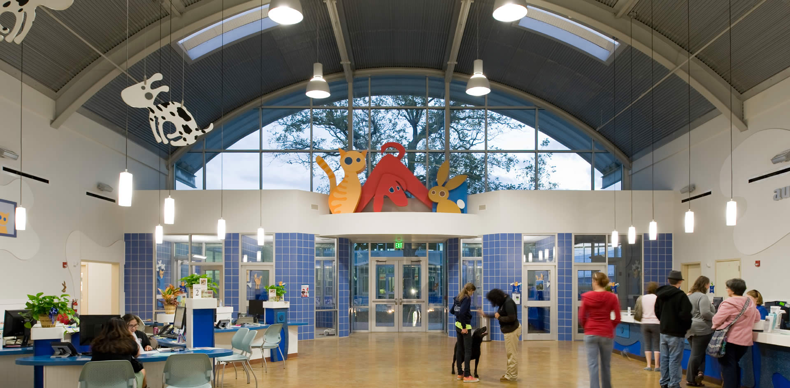


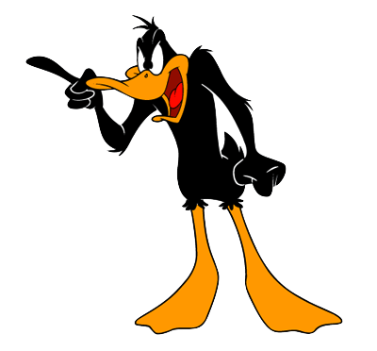
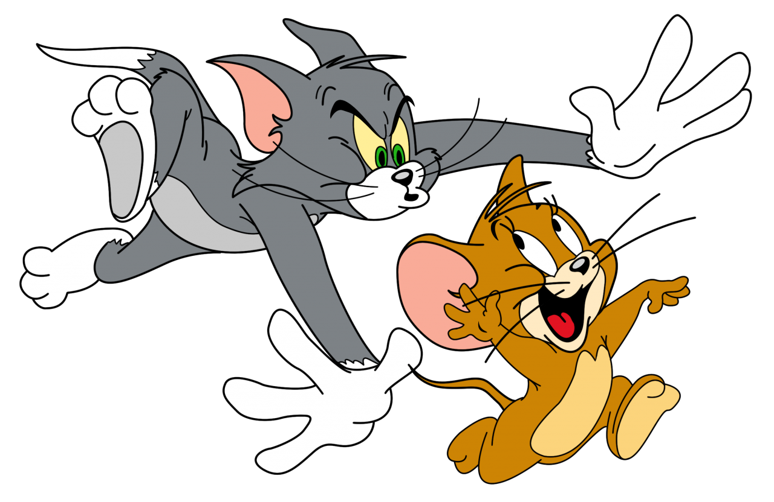
Austin Animal Shelter Analysis
Analysis of over 80,000 animal intake and adoption outcome data entries to predict the likelihood of adoption outcome
Prathima Bandi, Elijah Belizor, James Hook, Jack Kenning
Notes:
Good evening everyone
We will be presenting our analysis which focuses on the Austin Animal Shelter. AAC is one of the largest no kill shelters in the US caring for over 18000 animals per year, so its obviously a key institution for the local animal welfare community
For this study we analyzed over 80000 data entries for animal intake and adoption outcomes.
Our goal is to try and predict whether an animal will be adopted or not and to explore which variables influence adoption the most
Our team consists of Prathima Bandi, Elijah Belizor, James Hook, and Jack Kenning
Belizor James Hook, Jack Kenning Prathima Bandi, Elijah Belizor, James Hook, Jack Kenning

Slide 2
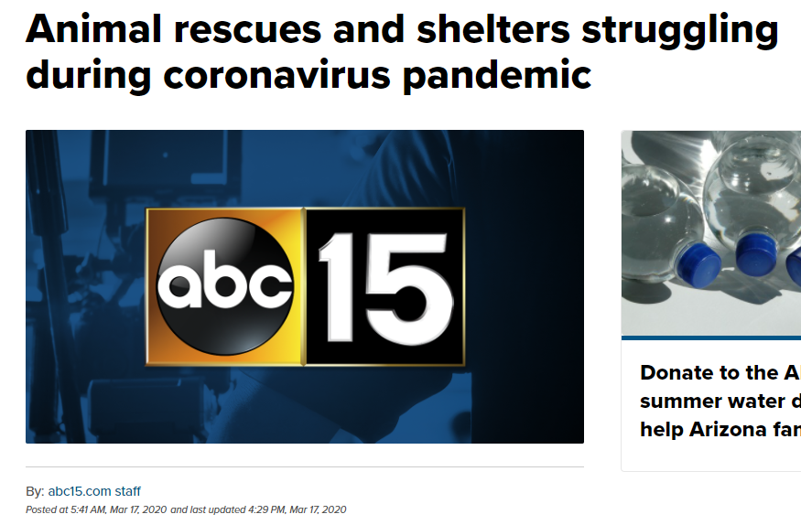
Why Analyze Animal Adoptions Data?
Potential to uncover useful insights to improve animal welfare in the area (and other regions)
Identify which types of animals may require additional support at shelters
Help prevent negative outcomes for identified high-risk animals
Assist with shelter resource, housing capacity, and budget planning
Shelters currently struggling to operate due to Covid-19 social distancing measures
Help inspire volunteer involvement in local animal welfare community
Notes:
So, why analyze animal adoptions data - what is the purpose of this analysis?
Any useful insights gained might be used to help improve the welfare of animals in the area, and finding could even potentially be applied to other regions
Identify which types of animals might need additional support while they are at the shelter and help prevent negative outcomes for what are identified as some of the most potentially high risk animals
A lot of these analyses could be used for planning purposes, its important for a shelter to have an idea how long particular types of animals will be in the shelter for food and lodging
Finally, as a team, we are all animal lovers - James has a particularly adorable Corgi, and we noticed that animal shelters have been struggling to operate due to social distancing measures over the past year and are low on manpower now things are opening back up again. We hope that by performing this analysis and sharing the results of this study we can help inspire people to volunteer in their local animal welfare community

Slide 3
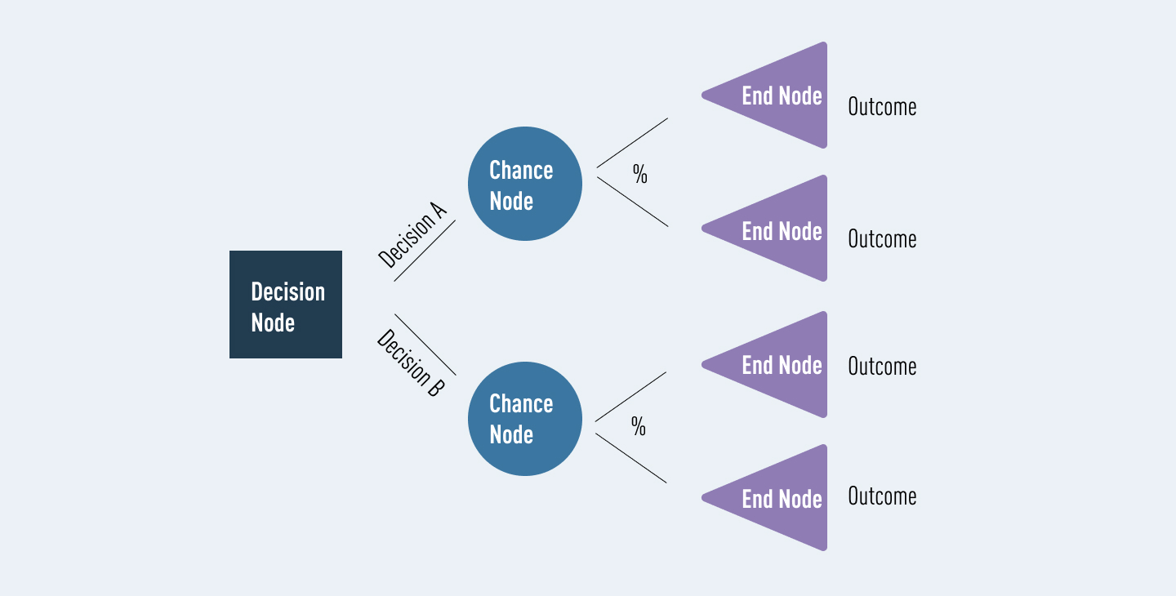
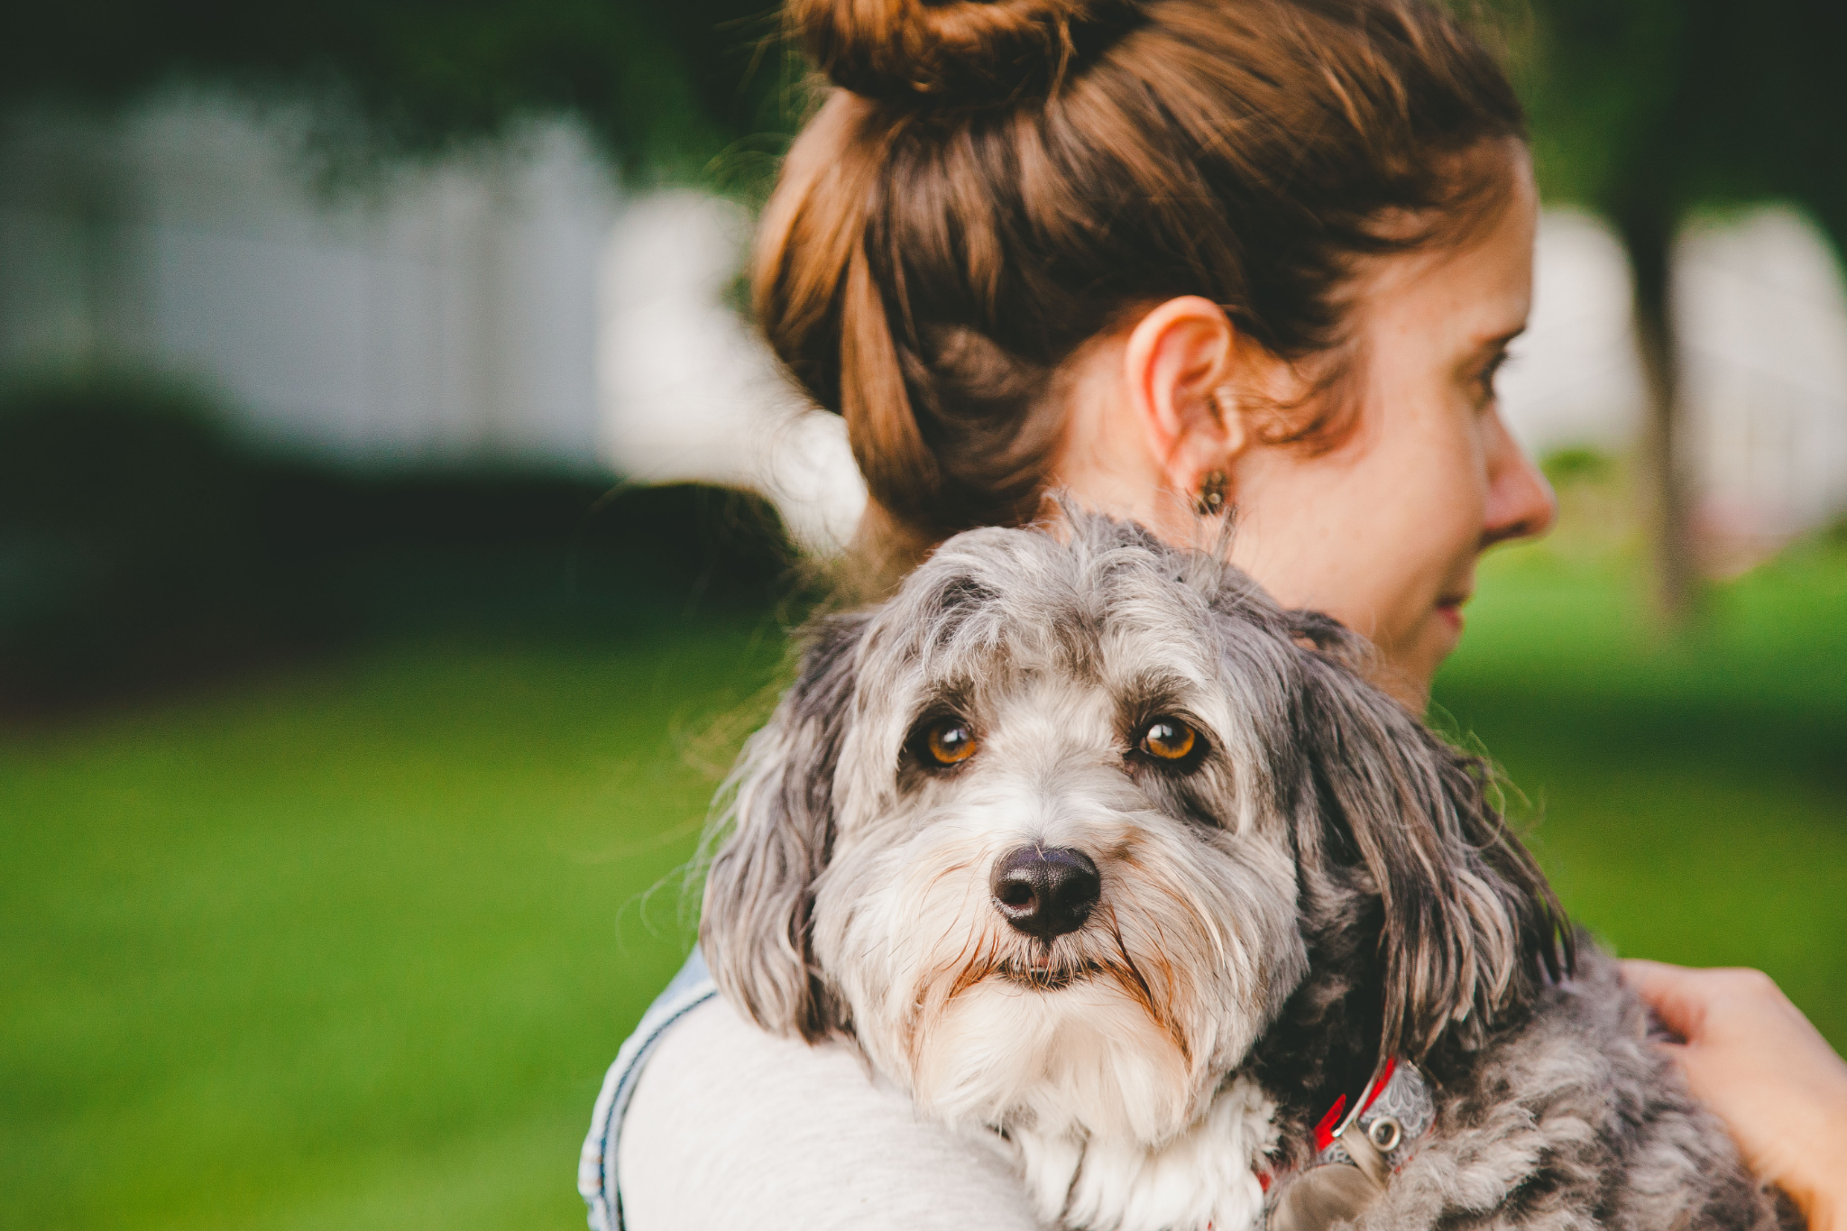
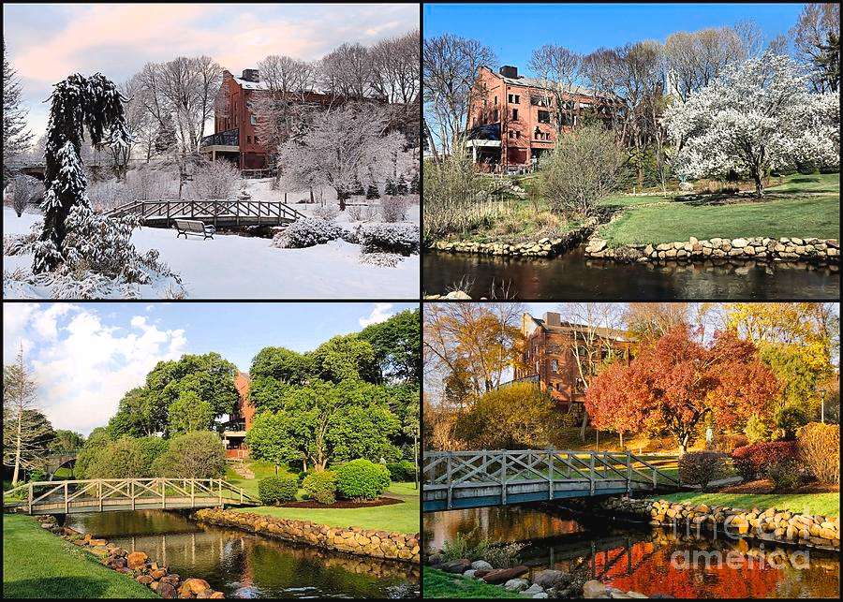

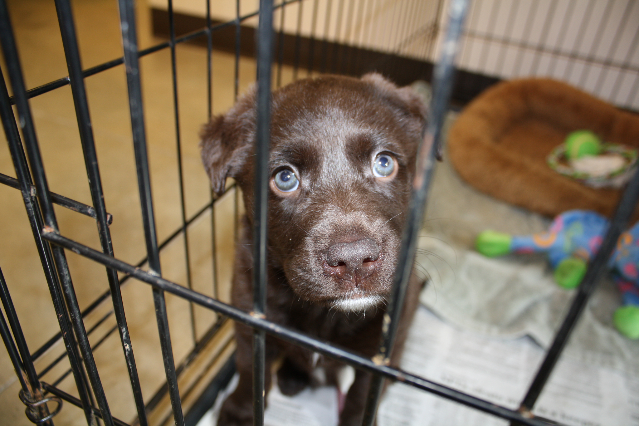

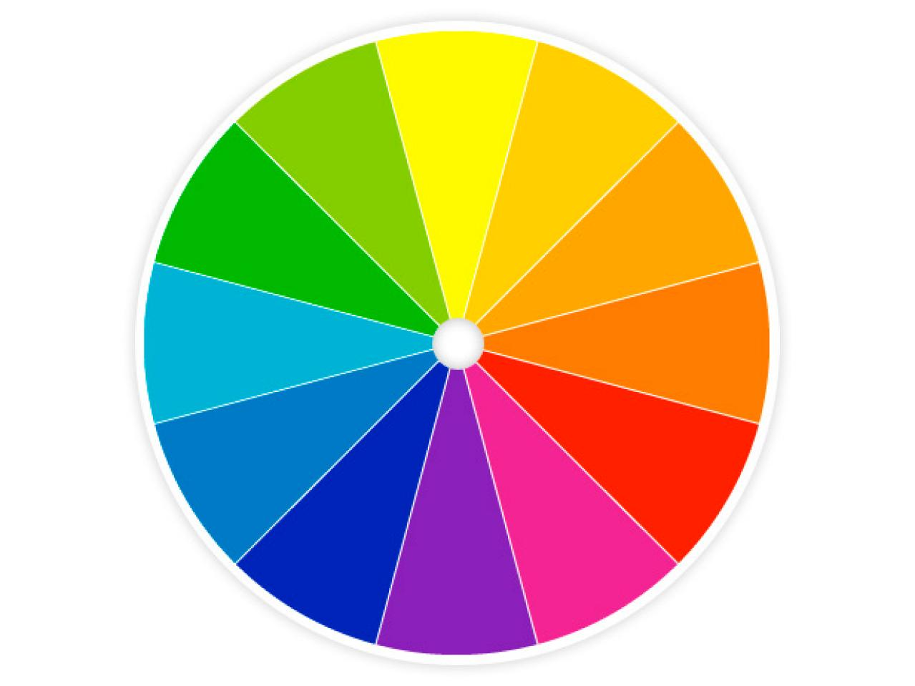
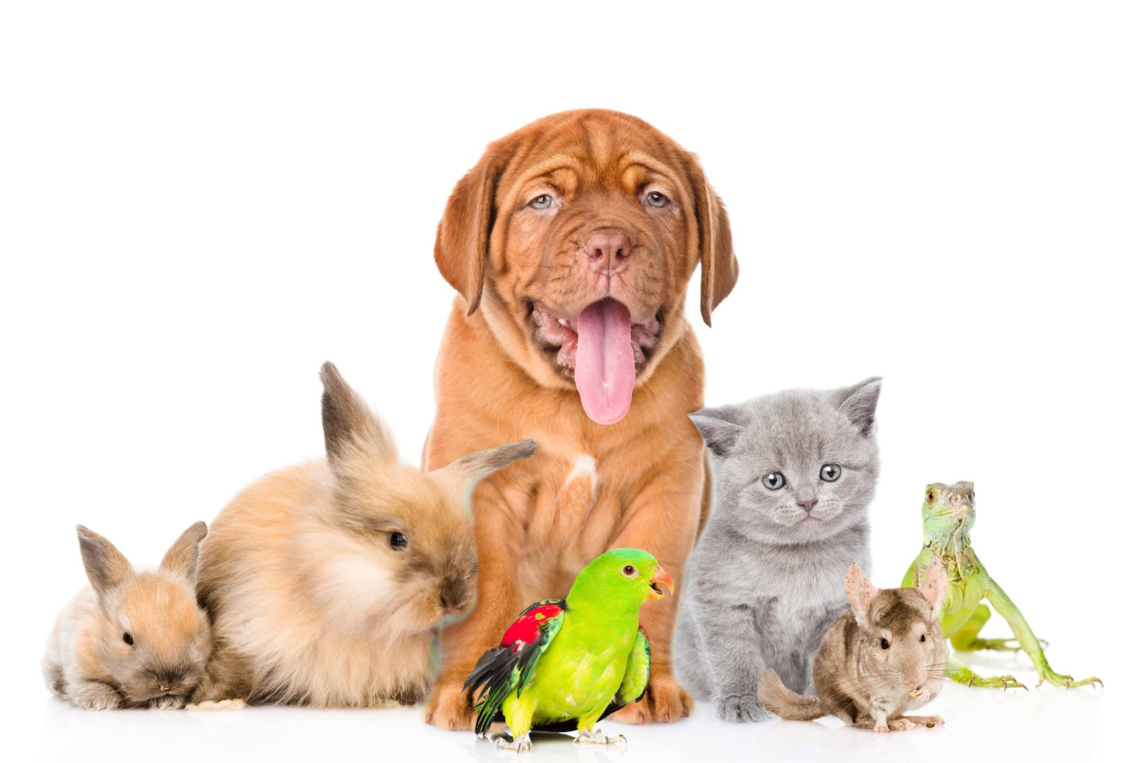
What Questions do we Hope to Answer?
Decision Tree Model Concept
- easy to interpret & perfect
for classification problems
Can a machine learning model be trained to effectively predict whether an animal will be adopted?
If not, what alternate model types might be more suitable to test?
What are the main factors controlling adoption intake and outcome for different animals?
Impacts of month of the year/day of the week on adoption outcome?
Impacts of animal specific traits on adoption?
What further analyses could be performed as future work?
ML Model Prediction
Explore & Characterize Trends
Animal more likely to be adopted (Outcome 1)
Temporal
predict vs.
By animal type
Animal less likely to be adopted (Outcome 0)
Other traits e.g. color
Time in shelter
Notes:
In terms of specific questions that the team hopes to answer, our key questions is whether our machine learning model can be trained to effectively predict adoption or not. We chose a decision tree model as it is very effective at classification problems and the model works from the main questions, posing a series of options that are available and calculating the likelihood of occurrence, ultimately arriving at one of our two outcomes.
If this model is not effective, we also wanted to think about what other types of model might provide better results
In addition to the ml model, we want to explore the main controlling factors, so we will be looking at intake and adoption trends for different days of the week and time of year, as well as the influence of factors such as animal age and time in shelter
Finally, we want to consider what other analyses we could perform in the future and what could be changed or done differently to improve the study

Slide 4
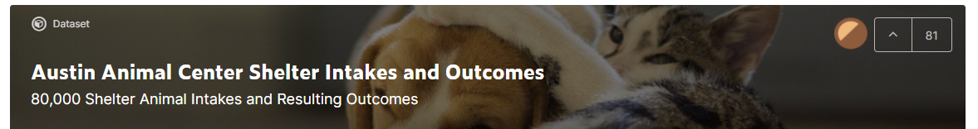

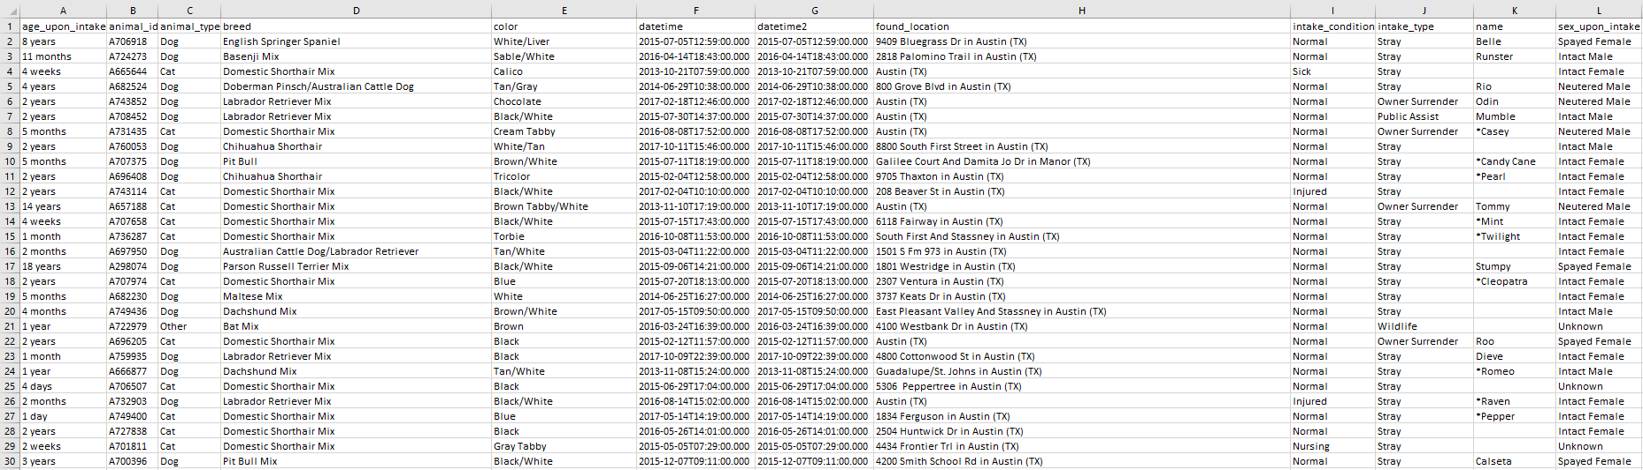
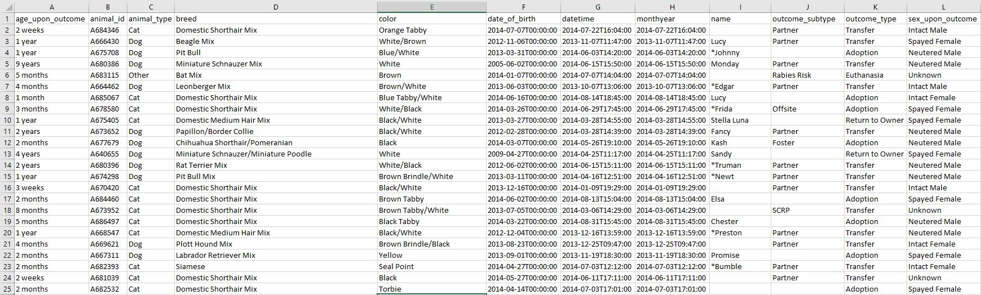
Where was the Dataset Sourced From?
Data sourced from a Kaggle dataset
Data publicly available as part of the City of Austin Open Data Initiative
Base dataset consists of separate tables for animal ‘intake’ and ‘outcome’ data, and a ‘merged’ table (latter used by team for study)
Dataset info:
Ranges from October 2013-2018
>80,000 entries, 12 columns
Datetime data to hourly frequency
Some animals enter/exit shelter multiple times
aac_intakes.csv
aac_outcomes.csv
Kaggle Dataset: https://www.kaggle.com/aaronschlegel/austin-animal-center-shelter-intakes-and-outcomes AODI: https://data.austintexas.gov/
Notes:
The dataset was taken from kaggle, and the animals adoption data is made publicly available as part of the city of austin open data initiative
The dataset consisted of three tables, one for intake data, one for outcome data and a merged table for all the animal data which is what was used by the team for the study
The dataset ranges over 5 years from oct 2013 to 2018, consists of over 80000 entries with 12 columns of data, time and date data to hourly frequency
Its important to note that some animals enter and exit the shelter multiple times so have more than one entry which needs to be addressed in the ETL stage
Links to the dataset and to AODI can be found at the bottom of the slide

Slide 5













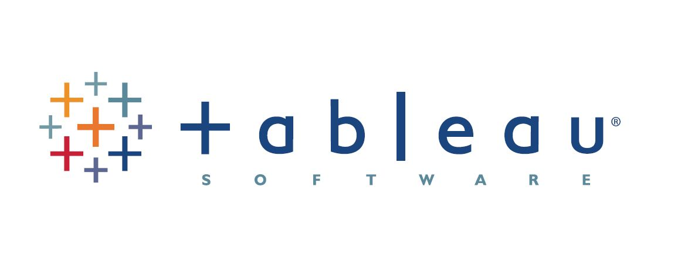
Tools and Resources Used By the Team
Software and Tools
Communication
Python - Language used for ETL, machine learning
Jupyter Notebook - Interactive development environment for Python
PostgreSQL - database storage
Slack - primary method of communication for day-to-day project needs and logistics
Zoom - bi-weekly check-ins/code review and for peer-assists
Pandas - ETL
SciKit-learn - Machine Learning library for Python
Seaborn/mpl - exploratory visuals
Text message - alternate/backup communication
Phone call - emergencies
Tableau - interactive dashboard
Github - project storage
Google slides - this presentation!
Notes:
Thank-you Jack. Good Evening everyone.
I will be talking about the tools and resources our team used for this projects, Overview of our DB and ETL process.

Slide 6
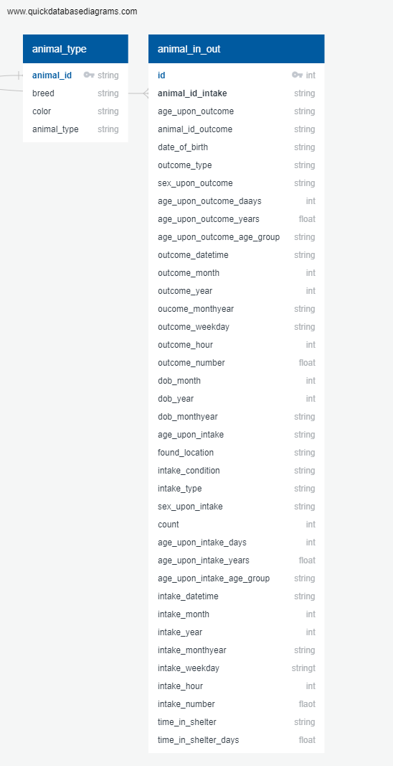
Data Exploration - SQL Database Creation Overview
‘Shelter_db’ created in PgAdmin
2) Database connection created with Pandas library to load in raw data
Postgres Database Schema - joined tables
‘animal_type’ lookup table - variables that remain the same for a specific animal
4) Copy created of raw data, transformations performed
3) SQL ‘Create’ script used to make master ‘animal_type’ table
‘animal_in_out’ table houses temporal data features that can change if an animal enters/exits the shelter multiple times
5) Created ‘animal_in_out’ table as dataset for analysis
6) Both data tables joined in the database
Notes:
Let’s take a look at out DB structure.

Slide 7
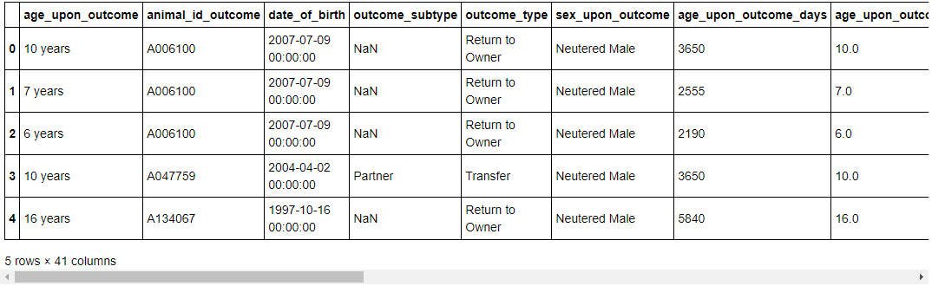
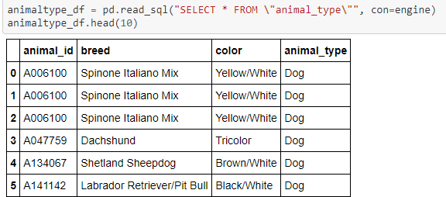
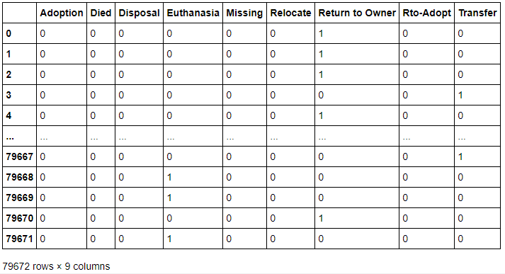
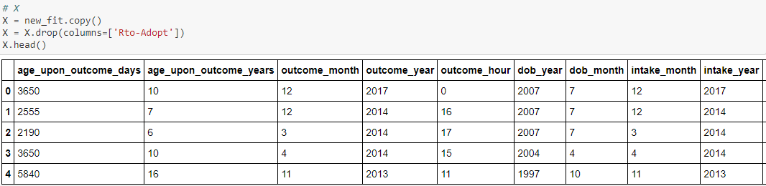
Pandas ETL Process - Key Points Summary
1
2
Raw file that was brought into the database and renamed columns to match SQL format, made transformations
Animal lookup table created in SQL containing ‘static’ data types, animal_in_out table reduced to ‘changeable’ data (i.e. datetime entries)
3
4
Final transformations made (e.g. drop target column, and additional categorical variables encoded) for final dataset, then input to ml model
Both tables joined with a created id and dummies created for ml database target variable (outcome_type)
Notes:
●Continuation of DB creation and explain the ETL concepts and work flow and talking through our preprocessing steps:
○Modeling concepts (Dimensions & Metrics)
○Raw data load
○Lookup table (Animal_Type) and explaining with a business case
Transactional dataset after removing Duplicates, Nulls and adding transformational columns
Reporting services Vs transactional database and how the ETL plays a major role in this process
Replication Services - A high-level overview

Slide 8
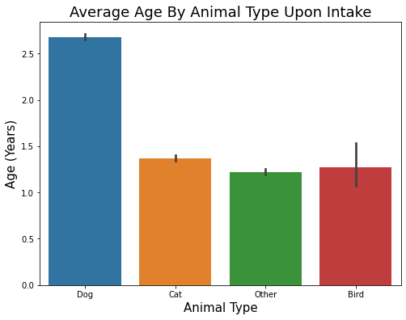
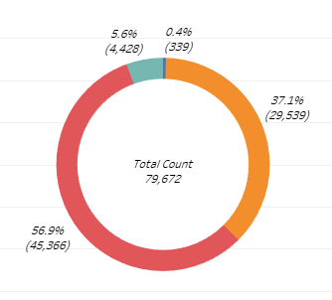
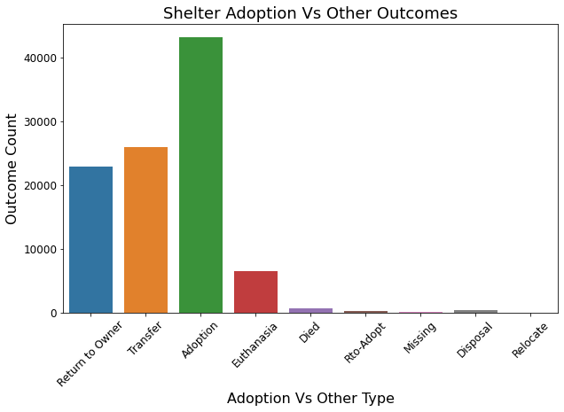
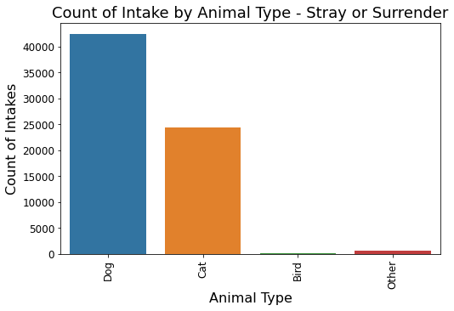
Dataset Overview - Exploratory Analysis
Count by Animal Type
Bird
Other
Cat
Dog
Notes:
Purpose of Exploratory analysis and how it benefits the business operations
The purpose of this exploratory analysis is to find trends in our data that will lead to better insight on the patterns of animal adoption. Some of our main focus points were animal type, age upon intake, time in shelter, weekday and monthly analysis. The data trends we find here will be used to identify animals that require the most attention in order to increase the likelihood of adoption, as well as the best times to focus increase focus on an animal.
Various tools (Excel, Power BI, etc.)
Give a quick overview of few charts and what decisions can be made to improve the operations

Slide 9
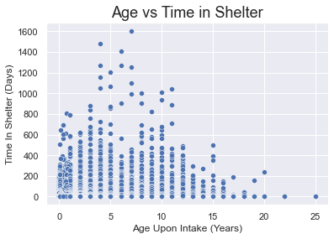
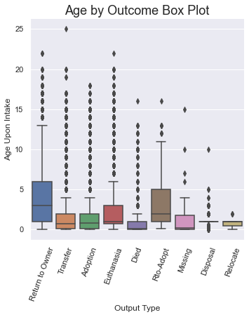
Impact of Animal Age and Time in Shelter on Outcome
Animals < ~4 years old more likely to be adopted or returned to owner quickly
Some animals more likely to be in the shelter for longer periods
...Seems to be a combination of factors
Are older animals spending less time due to likelihood of adoption or other reasons e.g. death by old age, euthanazia etc...?
Notes:
Key Points
Age vs Time
Animals 4 and under are far more likely to be adopted at quicker than other animals.
Older animals spend very little time in the shelter?
Are the older animals the ones who are returned to owners?
Very odd that ages 5-12 spend have the highest time spend in shelter overall
Potential cause of this may be that people prefer younger animals and the older animals are more likely to get returned to owner due to attachment?
Age by Outcome
We see that animals adopted are younger, and those returned to owners tend to be older

Slide 10
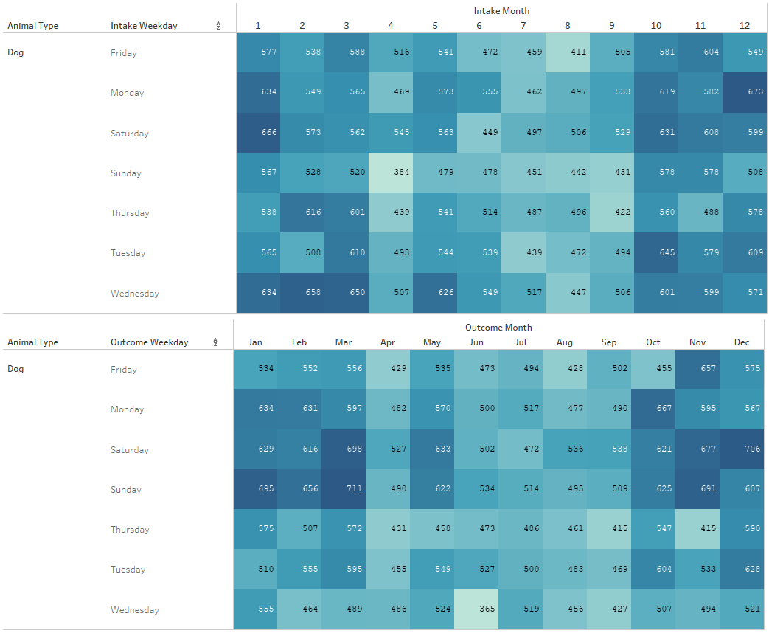
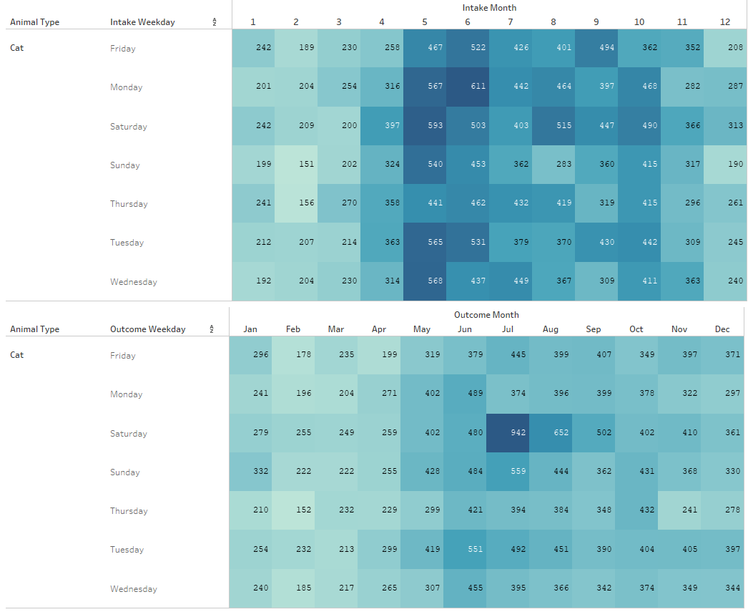
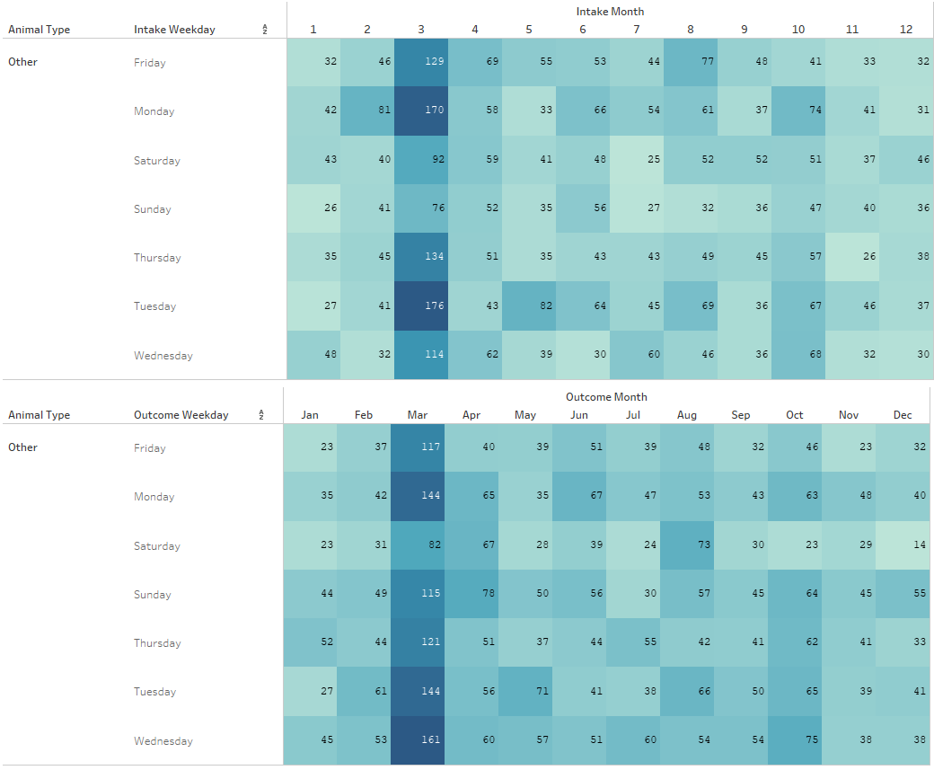
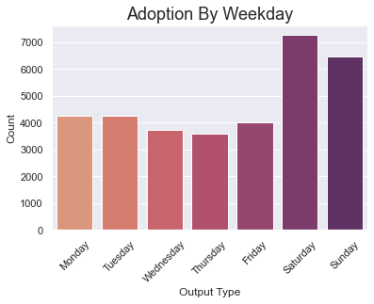
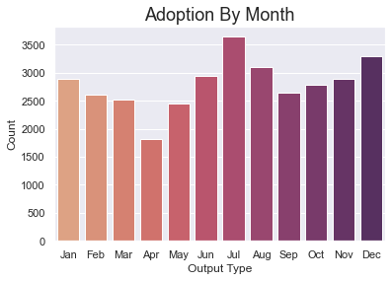
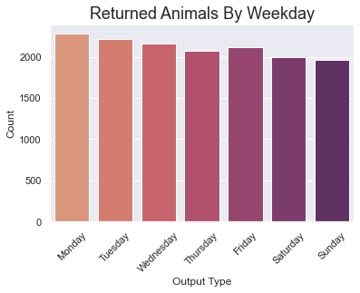
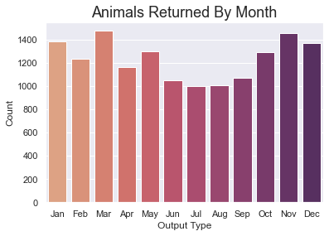
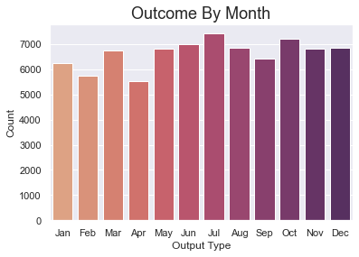
Monthly and Weekly Intake/Outcome Analysis
Day/Month Trends (“Dogs”)
Day/Month Trends (“Cats”)
Day/Month Trends (“Other”)
Overall Outcome Statistics
Notes:
Heatmap Trends
Dogs render the most activity during the beginning and end of the year
Cats render the most activity during the middle of the year, in particular the summer months
Why are animals that are not dogs and cats seeing the most activity during the month of March?
Bar Chart Trends
Adoptions are most likely to occur on weekends, may be a planned element to this
Adoptions occur most in the summer months and December
Animals returned to owners happen more uniformly, emotions cannot be measured
Animal returned to owens happens more likely during holidays and the beginning of the year

Slide 11
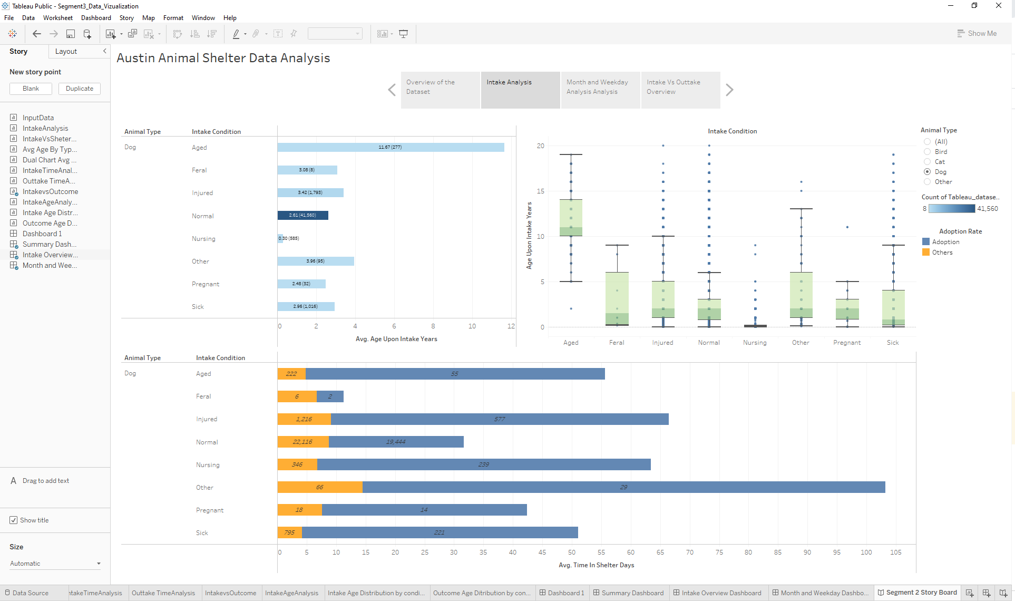
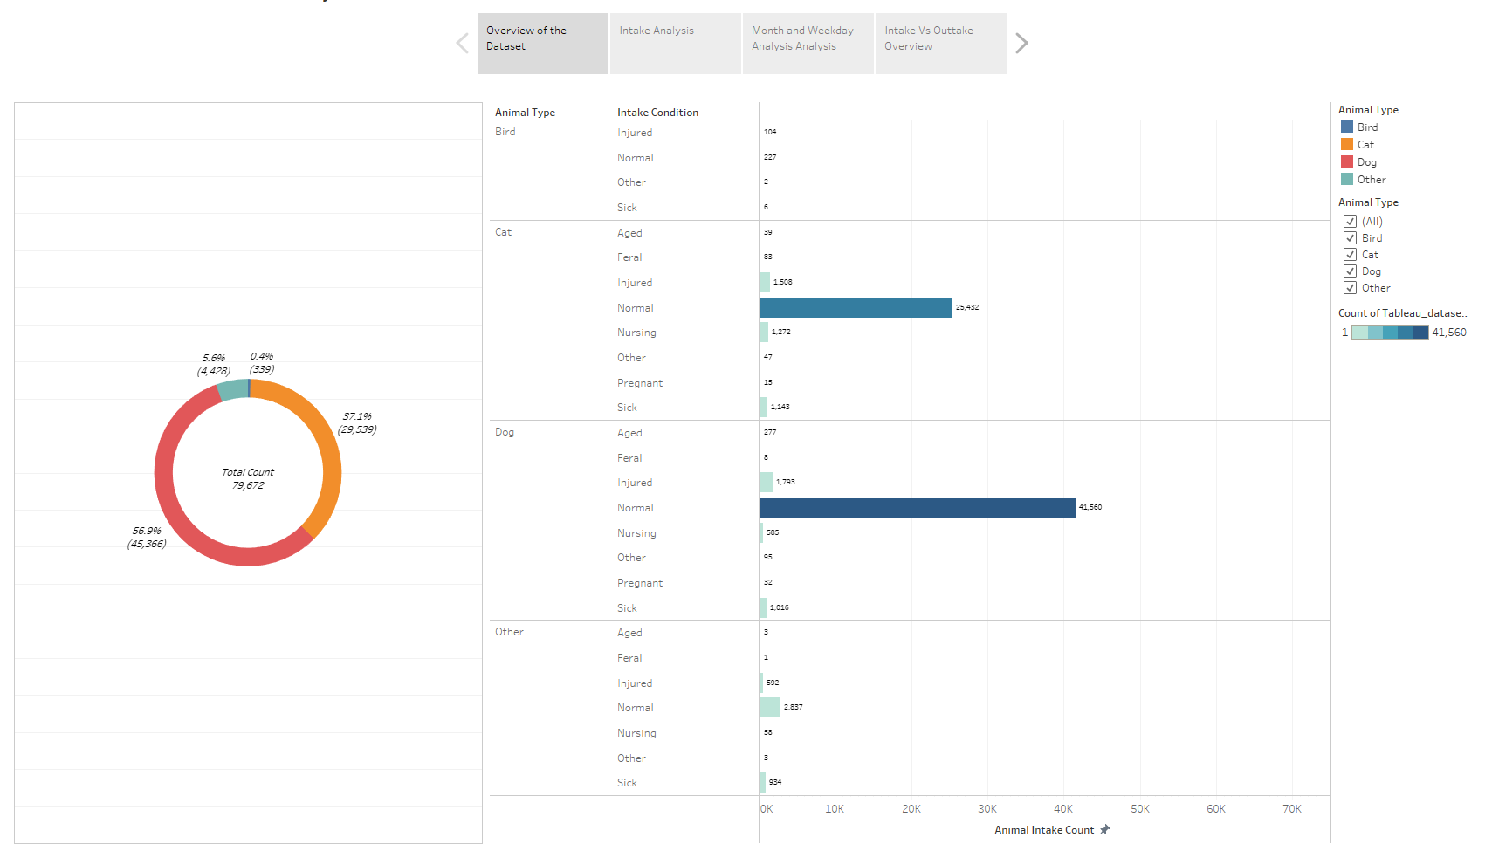
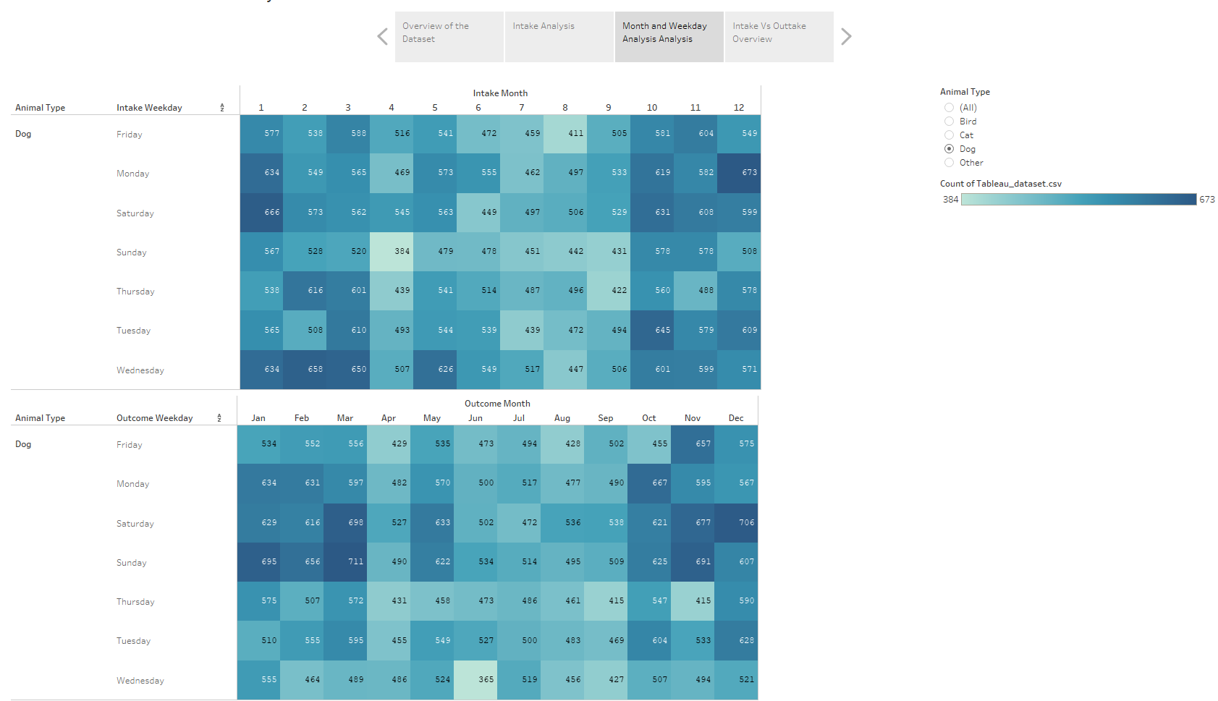
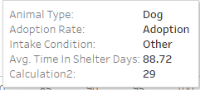
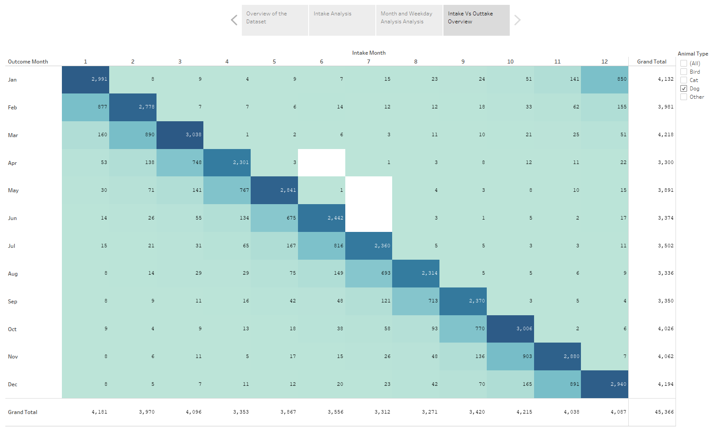

Results Visualized Using Interactive Tableau Dashboard
Interactive tabs to switch display topic
Selection reticle allows filtering by criteria, such as animal type
Tab 1 - Overview
Storyboard format to switch between multiple dashboard displays is user friendly
Tab 3 - Month/Day
Tab 2 - Intake Analysis
Tab 4 - Intake/Outcome
Mouse over tooltip to highlight chart data
Tabs to visualize individual components of the storyboard
Link to Dashboard: https://public.tableau.com/app/profile/prathima.bandi/viz/Segment3_Data_Vizualization/Segment2StoryBoard

Slide 12
Machine Learning Model Creation Overview
1) Connect model to database
2) Preprocess data (encode categorical variables)
3) Define target variable
10a) Iterate with changes if necessary
5) Scale the data
4) Split data in Train and Test datasets
7) Fit the model with Training data
6) Plot the tree model
10b) Publish model results
9) Review confusion matrix, accuracy, classification report results
8) Make predictions from test data

Slide 13
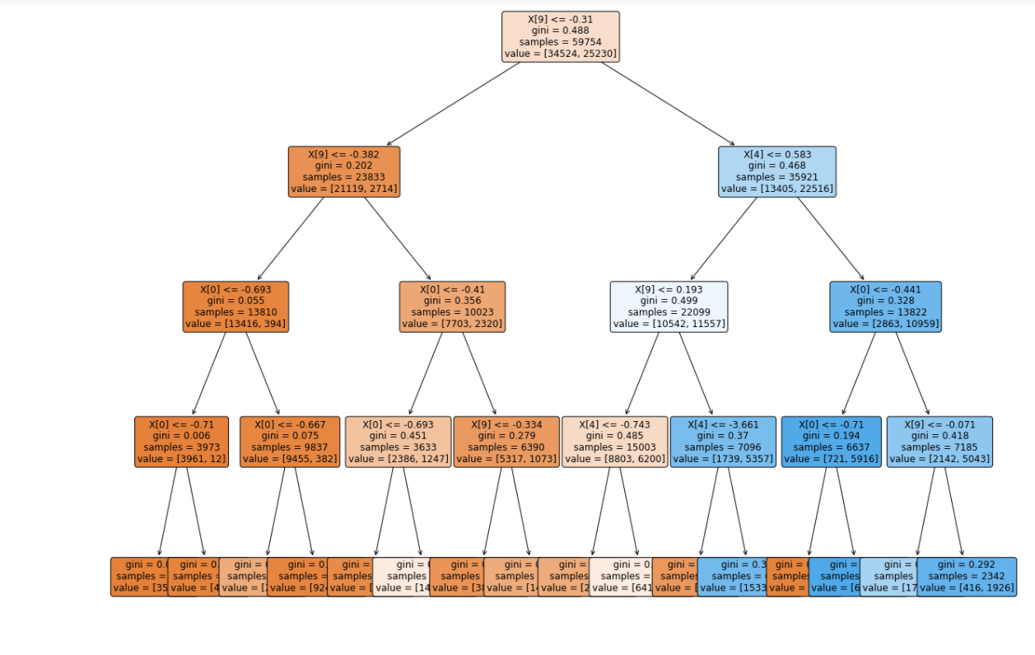
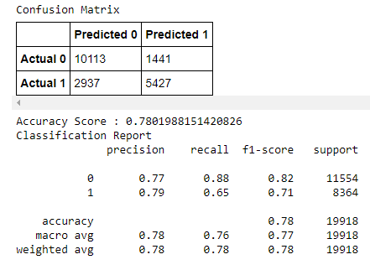
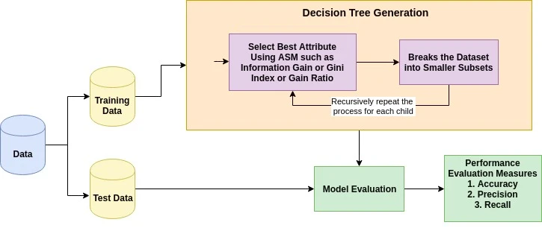
Machine Learning Model Analysis Results
Decision Tree Model Plot
Confusion Matrix and Classification Report
Adopted = 1
Not Adopted = 0
TN = True Negative
TP = True Positive
FN = False Negative
FP = False Positive
(TN)
(FP)
(FN)
(TP)
0.75 minimum target
Decision Tree Training Process
% of correct predictions
TP/(TP + FP)
% positive predictions correct
2*(Recall*Precision)/
(Recall + Precision)
% of positive cases caught TP/(TP + FN)
Notes:
Plot of the current iteration of the decision tree model. The goal is to progressively split and separate samples with a more similar structure that will result in more pure subsets of data.
The tree ends up with a series of branches (i.e. questions and answers) that eventually lead to a classification prediction representing a probability of a particular outcome.
Confusion matrix and classification report. The model currently achieves accuracy 78% which is just above our minimum accepted threshold of 75%. However further iterations may be able to improve the model performance.
A decision tree may not be the best type of model for this analysis, it is possible that superior results may be possible with a Random Forest model.

Slide 14

Summary and Conclusions
Machine Learning Model Performance
Decision Tree ML model is able to predict adoption outcome (78%) above minimum target accuracy threshold (>75%)
Suggests variables can indicate adoption outcome
But, performance likely limited by current dataset/model
Key Exploratory Analysis Findings
Majority of animals receive an “outcome” within 1-2 months
Majority of adoptions occur at the weekends and in summer months (except December - animals as xmas gifts?)
Most animals are returned to owner at the start of the week and in winter months (particularly March - also xmas link?)
Most animals adopted or transferred are under 2 years old, older animals are just as likely to be returned to owner as adopted
Older animals spend less time in the shelter due to a combination of different factors/outcomes
Recommendations for Future Work
Explore use of Random Forest as alternate ML model - potential to improve performance?
Further research to examine potential reasons behind observed trends
Additional iterative analysis to explore relationships/links between variables
Random Forest model
- combine multiple decision trees
Notes:
Additional analysis to perform - more pre-processing/data cleaning would help with more types of visualization e.g. breeds spelt differently but actually same breed
Analyze down to hourly data (not just weekly and monthly)

Slide 15
Backup

Slide 16
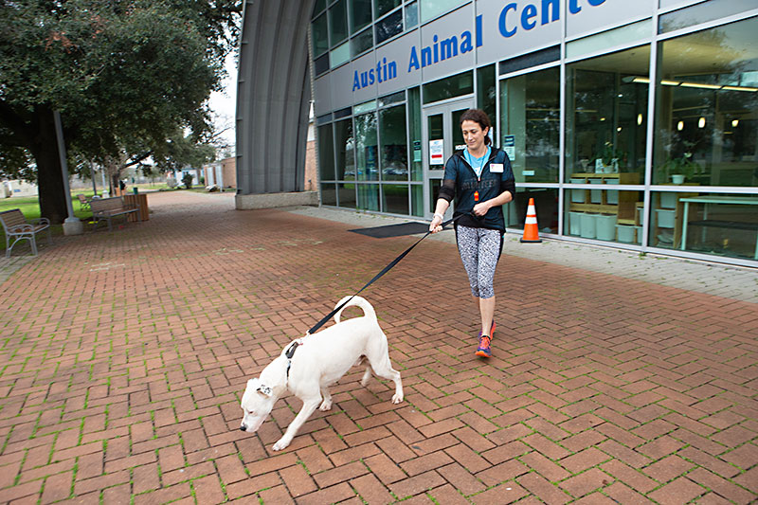
Study Overview
Austin Animal Center (AAC) is one of the largest no-kill animal shelters in the U.S, caring for over 18,000 animals per year
This study aims to explore which factors most influence adoption outcomes and whether there is a predictable pattern
Through a supervised machine learning model, the goal is to attempt to predict adoption outcome for animals based on multiple criteria
Notes:
So what is our study about?
As mentioned, we are looking at the Austin Animal Center. The AAC is one of the largest no kill shelters in the US and cares for over 18,000 animals per year. So its really one of the most important instiutitons supporting animal welfare in the region
With our study, we hope to try and determine which factors most influence the likelihood of an animal being adopted and explore whether there are any patterns that can help predict whether an animal will be adopted and conversely, and just as importantly whether an animal will not be adopted
The ultimate goal is to try to predict these liklihoods and well be attempting that through a supervised machine learning model, which will be trained from a multitude of variables contained in the dataset

Slide 17
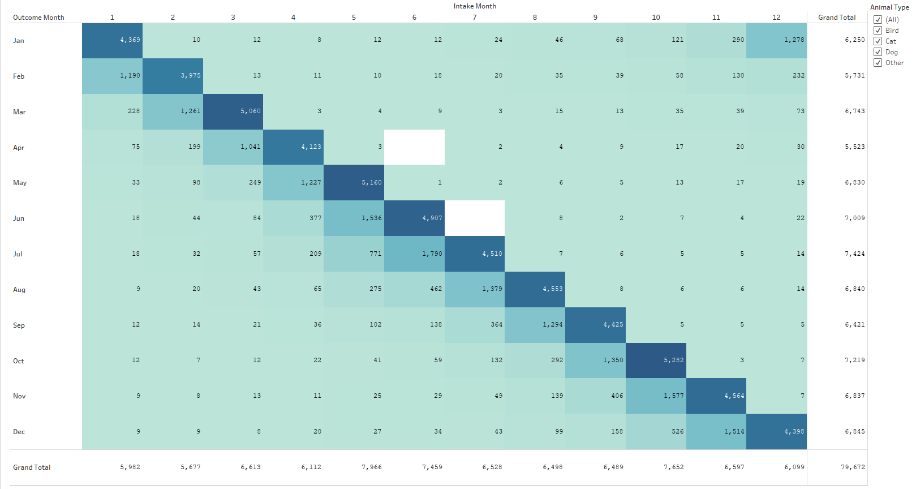
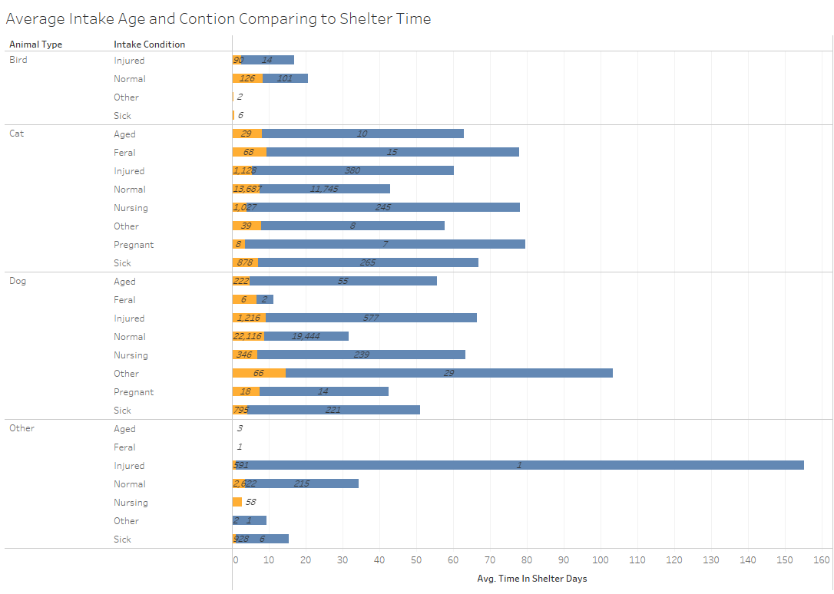
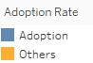
Intake vs. Outcome Overview
Notes:
This heat map reveals that there needs to be a sense of urgency during the animals first 2 months in the shelter
Most animals do not spend more than 2 months in the shelter, with the majority of animals getting a decision rendered within the first month

Slide 18
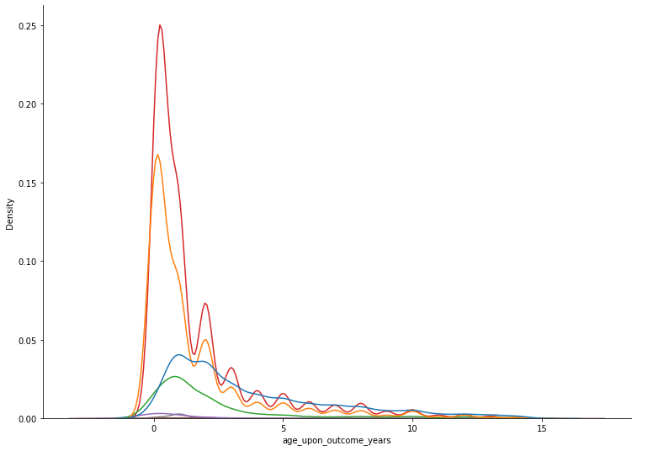
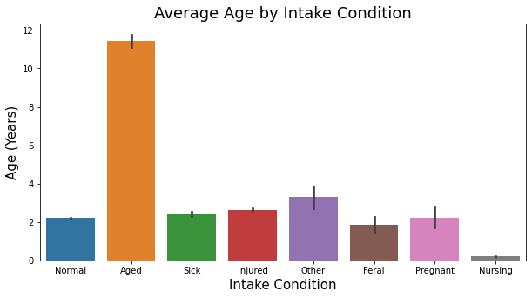
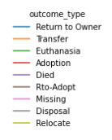
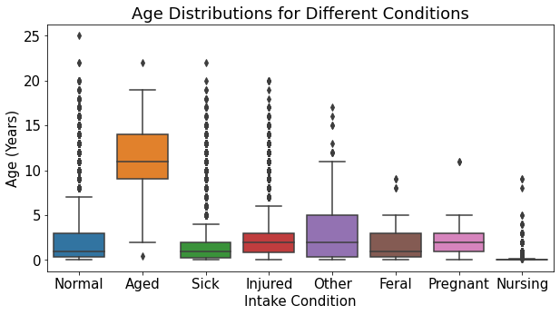
Exploratory Analysis - Animal Age Trends
Most animals adopted or transferred are under 2 years old, older animals are just as likely to be returned to owner as adopted
Unsurprisingly the the average age on intake condition is highest for animals classified as ‘aged’, other conditions are more or less even by comparison
On average dogs are older than other animals upon intake probably due to their longer lifespan

Slide 19
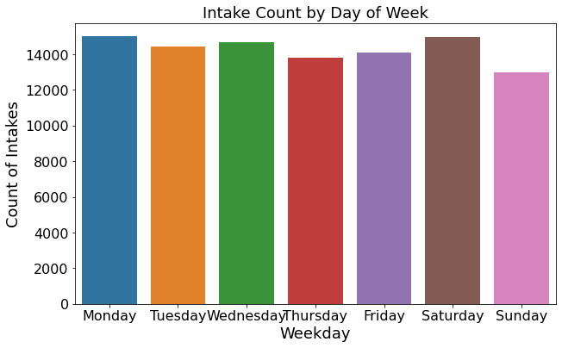

Exploratory Analysis - Intake Date/time Trends
Sunday is the least likely day that an animal will enter the shelter, followed by thursday and friday. Intakes are high at the start of the week from mondays, and also highest on saturdays
Early summer months in may and june see increased intakes counts for animals as well as approaching winter in october

Slide 20
Exploratory Analysis - Outcome Date/time Trends
Saturday and sunday are most popular days to adopt
Animal returns more likely at start of the week, decreasing throughout
Adoptions most common in the summer, also end of the year (xmas?)
Most animals returned in winter months
Fewer overall ‘outcomes’ in first quarter of the year

Slide 21

Exploratory Analysis - General Insights
Adoption is the most likely outcome for an animal overall by almost a factor of 2-1. However significant numbers are returned to owner or transferred. Other factors make up comparatively smaller proportion of outcomes - may decide to try to group when iterating ml model ?
Cats and miscellaneous other animals will generally spend the most time in the shelter compared to dogs and birds
Dogs are the most likely animal to be taken in as a stray or surrendered, followed by cats

Slide 22

Exploratory Analysis - Adoption Outcomes by Animal Type
Dogs are the most common animal at the shelter and most likely to be adopted, with many returned to owner or transferred
Cats are most likely to be transferred but almost as many are adopted, relatively few returned to owner
Miscellaneous other animals are most likely to be euthanized compared to any other outcome
Birds are uncommon at the shelter and a mostly a mix transfer, adopted, and euthanized

Slide 23
Storyboard for Tableau Dashboard Outline
Data count and selection tool makes sense to start
3
Temporal impacts on intake and outcome
4
Age specific controls on intake and outcome
1
2
High level overview charts of data
Total animal count
Selection menu (dropdown or checkbox combo filters for each variable in dataset - controls all relevant chart displays)
Pie chart showing counts by outcome type
Heat map of outcome type count vs days of the week
Age upon intake vs. count per outcome type (multi-line graph)
Age upon outcome vs. count per outcome type (multi-line graph)
Total currently selected animal count
Animal type intake count part-to-whole chart
Heat map of outcome type count vs months of the year
Adoption outcome is target variable and most important to see relationships with all other variables, multiple smaller charts here need to be heat maps as vs. categorical variables remaining
5
Multiple correlation matrixes/heat maps or linear plots for adoption outcome type count vs each variable (animal type, breed, color, age on intake, age on outcome, sex on intake, sex on outcome)
Data table mini-inset (results filter based on selection menu above, searchable/scrollable)
Animal type vs. time in shelter bar chart
Time in shelter vs. count per outcome type (multi-line graph)
Data table
Selectable Tabs in Tableau to further explore
Tabs for each individual chart
6
Dashboard
Story

